Slide 1


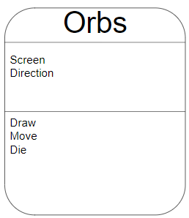
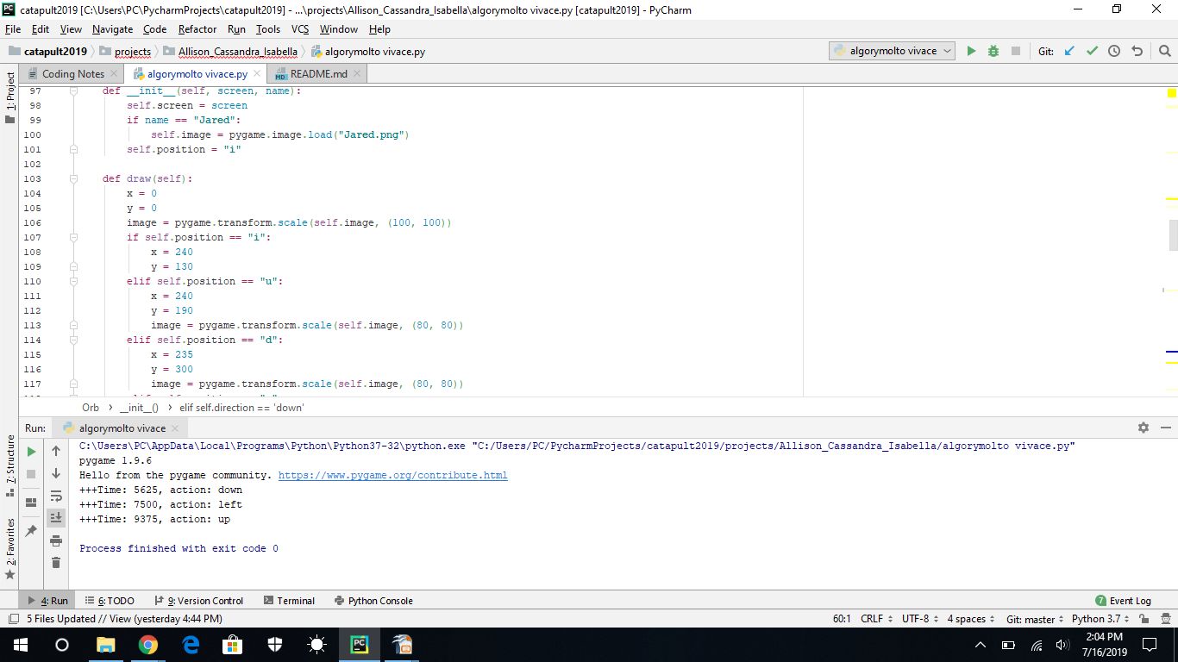
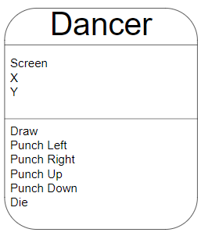
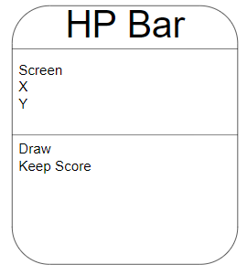
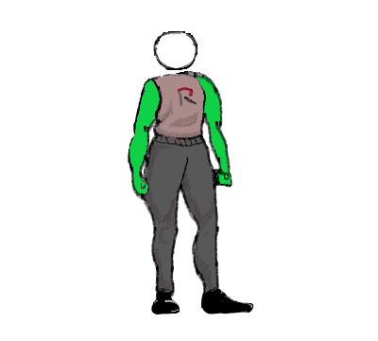
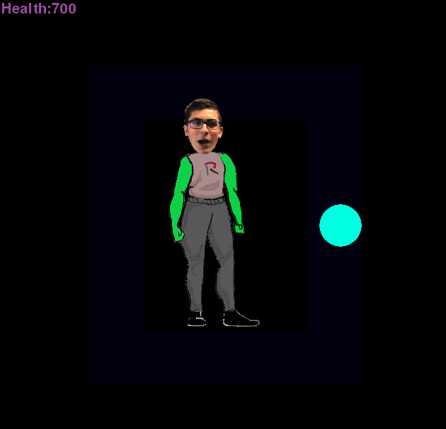

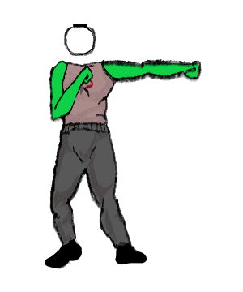
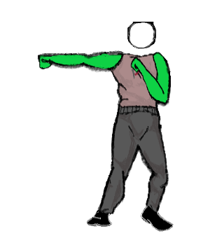

Team #09
Algorymolto Vivace
Beat Fighter
Operation Catapult 2019
Allison, Cassandra, Isabella
- Beat Fighter is a rhythm-based fighting game in which the player tries to defeat enemies in time with the music
- attack in different directions by using the arrow keys
- punch as enemies enter range
- try to attack enemies in time with the musical beat for maximum effect
- watch the hp points, they lower as the player takes damage
Uml charts
FEATURES TO IMPROVE
- multiplayer mode to allow for competitive playing
- more levels with different music
- more complex choreography
GAME FEATURES
- controllable player character
- enemies from different directions
- hp bar that lowers as damage is taken
- fully choreographed attack pattern

